Slide 1
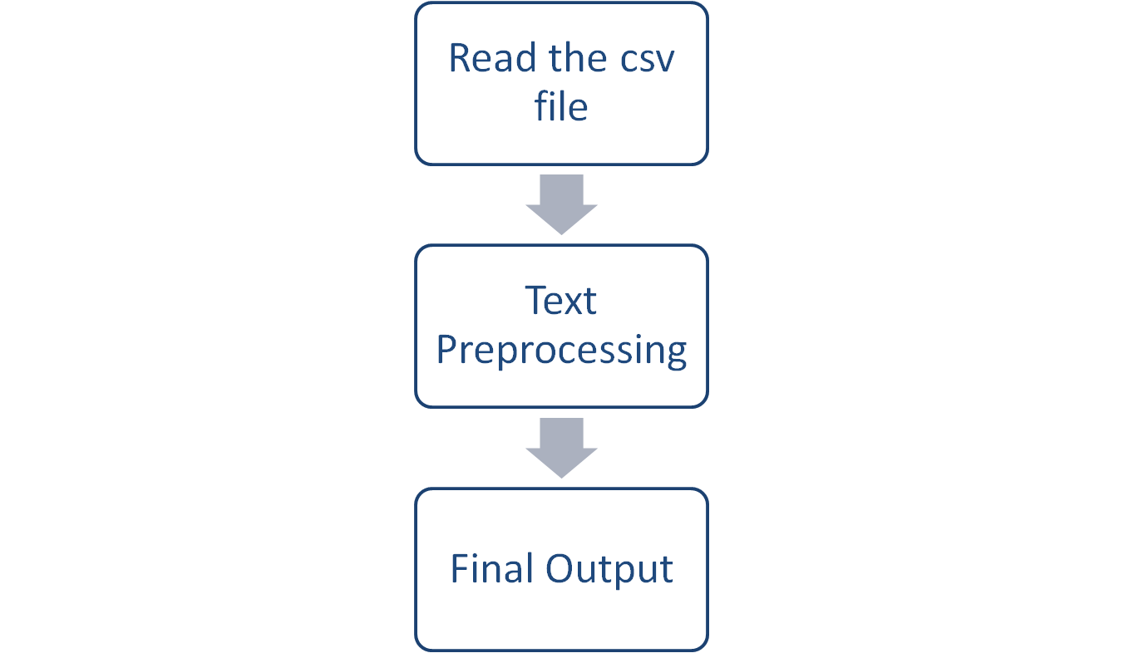
Project-DESIGN

